Slide 1


SEED CERTIFICATION USING ARTIFICIAL INTELLIGENCE

Slide 2
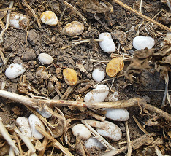
PROBLEM STATEMENT
Seed quality issues have been demanded a need for effective traceability solution.
It is estimated that the direct contribution of good quality of seed alone to the production of seed is 15%-20%
Features such as color crack etc.. Are the basic parameters in validating seed quality
Monitoring of 130 seed laboratory in the country is difficult task.

Slide 3

PROTOTYPE DEMO

Slide 4
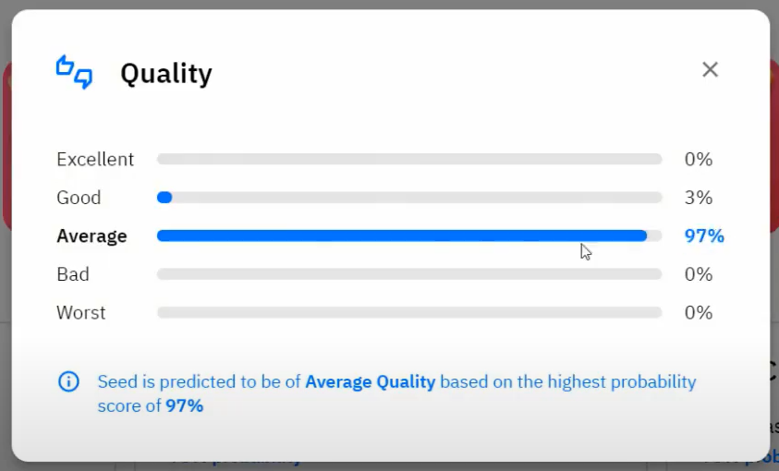
NOVELITY
Artificial neural network has a ability to find magnetic induction of 150 and 200 Mt for better germination
This method will replace time consuming physical grow out method using tetrazolium manual testing.
The automated data will be stored in distributed cloud system

Slide 5
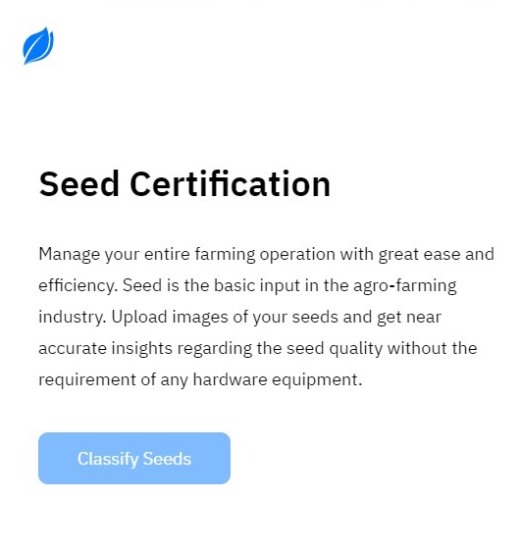
SCALABILITY
Improves capital optimization, Reduces counterparty risks, Improved
Instant and efficient verification of the seed quality based on the provided data
30 days is taken in laboratory to test the samples of the seeds.
The data of the samples of maize seed is stored in cloud computing after germination test

Slide 6
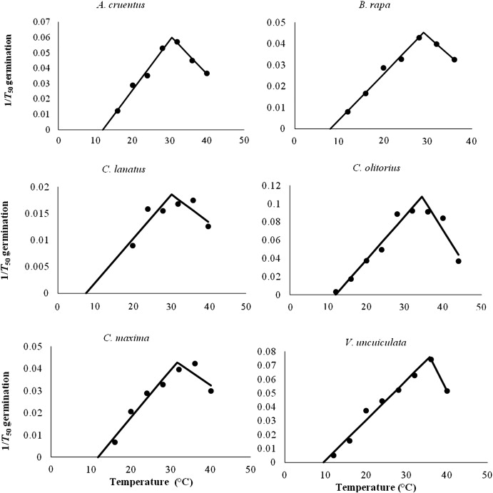
IMPACT
130 Labs and 700 testing's reduces the time for testing and accuracy
10% improvement of quality of seed and increase in income
The increase in growth seed production will be 14 billion USD by 2025 using AI.

Slide 7
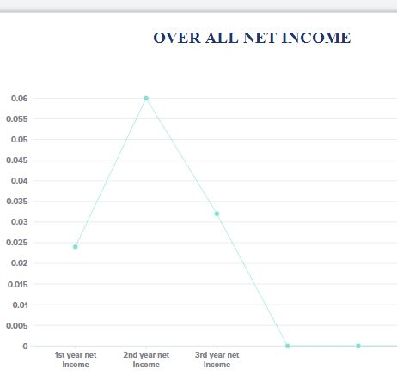
BUSINESS MODEL
Model allows the customer – Seed certifying agency to use the services by paying the fixed amount for every 1kg of seed sample after testing .
Monthly Subscription for 1 kg of seed is Rs.15 .
Annual subscription for using seed testing software is Rs 70 / kg
1 kg of seed with annual subscription cost for using seed testing software varies according to the type of seed data being used.

Slide 8
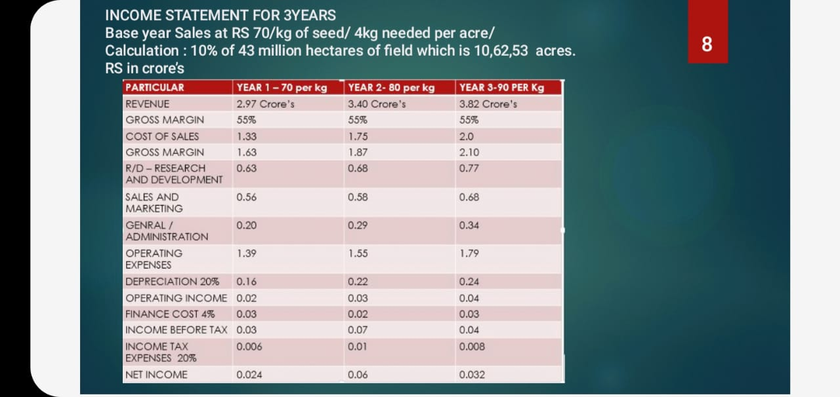
MARKET VALUE
Manual testing costs around Rs.35 per kg which makes it Rs. 4,515 crore.
Revenue will be generalized based on the samples of the seed and seed testing is tremendous based on seed samples of annual basis of customer (state government)
Indian seed estimation reaches value of $3.6 billion in 2020 growing annual rate of CAGR of around 17 percent.

Slide 9
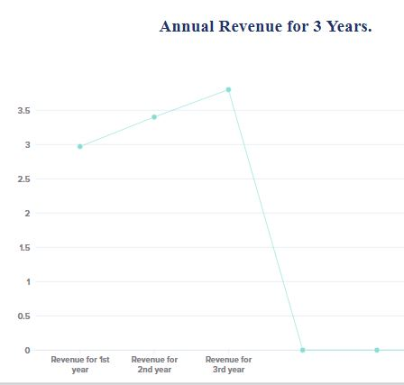
BUSINESS PLAN – REVENUE BASED
Base year sales rate is around Rs. 70 per kg of seed.
Calculation : 10% of 43million hectares of field which is 106253 acres Rs in crore’s.
Annual Revenue for seed Testing:
1. 1st year – Rs. 70 per kg of seed – 2.40 Cr
2. 2ND year – Rs. 80 per kg of seed – 3.40 Cr
3. 3rd year- Rs. 90 per kg of the seed – 3.80 Cr

Slide 10




Name: Akhil Sanker Role: AI Deployment / Implementation
B. Tech CSE department
3rd year
Name: Min Oviya S Role: Idea Development
B. Tech ECE department,
3rd year
Name: Melvin Abraham. Role: UI design / Implementation
B. Tech CSE department
3rd year
Name: Jeshron Sonali A
Role: Idea Documentation
B. Tech ECE department
3rd year

